Slide 1
Lecture 2
Properties Of Cryogenic Fluids
J. G. Weisend II

Slide 2
Goals
Introduce basic definitions used in describing cryogenic fluids & their properties
Describe important fluid properties and their variation with temperature and pressure
Introduce the law of corresponding states
Describe where fluid properties may be found
Mention unique properties of Hydrogen & Helium (more in later lectures)

Slide 3
Introduction
Due to the wide temperature & pressure ranges covered by cryogenics the properties of fluids vary greatly – we generally can’t assume constant properties.
Understanding changes in the thermodynamic state of the fluids allows us to describe refrigeration and liquefaction cycles
With the exception of Helium and Hydrogen, pure cryogenic fluids act as classical Newtonian fluids
Fluid properties are well known (mostly) & many resources exist

Slide 4
Typical Properties
Density
Specific Heat
Enthalpy (h (J / kg)): h = u + Pv
Entropy (s ( J / Kg K)): In a reversible process: ds = dQ/T
Thermal Conductivity
Viscosity

Slide 5
Some Definitions
Supercritical Fluid: a fluid that may no longer be thought of as a liquid or a gas but only as a fluid. Such a fluid is either above its critical temperature or critical pressure or both.
  The accuracy of calculated thermodynamic values becomes relatively inaccurate around the critical point
Subcooled or Pressurized Liquid: A liquid whose temperature or pressure places it below the saturation curve
Triple Point: The point in thermodynamic space in which the solid, liquid and vapor phases of a substance coexist.
T-S ( temperature – entropy) Diagram: Used to both display graphically fluid properties and frequently to describe refrigeration cycles
Isenthalpic Expansion: changing from high to low pressure along a line of constant enthalpy

Slide 6
Some Definitions
Isentropic Expansion: changing from high to low pressure along a line of constant entropy
1st Order Phase Transition: A change in phase in which there is a discontinuity in the specific heat and which requires latent heat
2nd Order Phase Transition: No discontinuity in specific heat and no latent heat is required

Slide 7
Some Key Parameters of
Cryogenic Fluids
Fluid | Normal Boiling Point (K) | Triple Point (K) | Critical Temperature (K) | Critical Pressure (kPa)
Krypton | 119.8 | 115.8 | 209.4 | 5496
Methane | 111.6 | 90.7 | 190.6 | 4599
Oxygen | 90.2 | 54.4 | 154.6 | 5043
Argon | 87.3 | 83.8 | 150.9 | 4906
Nitrogen | 77.4 | 63.2 | 126.3 | 3399
Neon | 27.1 | 24.6 | 44.4 | 2703
Hydrogen | 20.3 | 13.8 | 32.9 | 1283.8
Helium | 4.2 | N/A | 5.2 | 227.46

Slide 8
Generic T-S diagram Showing Isenthalps,
Isobars and 2 Phase Region

Slide 9
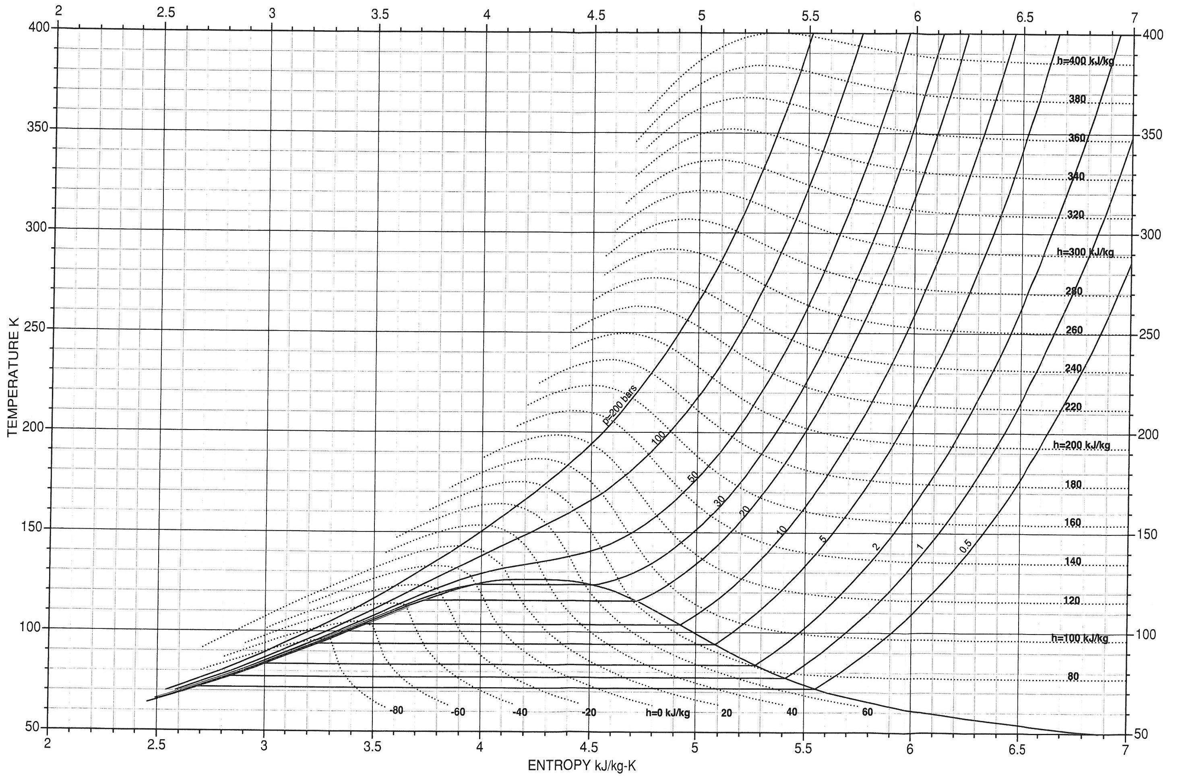
T-S Diagram for Nitrogen

Slide 10
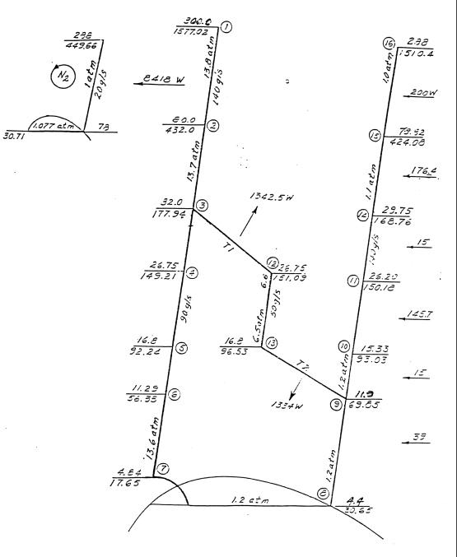
T S Diagram illustrating a Refrigeration Cycle

Slide 11
The Law of Corresponding States
With the exception of helium and hydrogen, the properties of cryogenic fluids can be scaled from one fluid to another with a fair accuracy provided the properties have been normalized (typically by the critical properties of the fluid).
This is useful in looking at the general shape of properties

Slide 12
Normalized Density of Oxygen as a
Function of Pressure &Temperature

Slide 13
Cp/R for Oxygen as a Function of
Pressure & Temperature

Slide 14
Thermal Conductivity of Oxygen

Slide 15
Equations of State
Allow calculation of all thermodynamic state properties
In theory, are based on the interactions of a molecule with its neighbors
In reality, are highly empirical
  A simple example is the ideal gas law:
  A(ρ,T) = RT (log ρ - a log T + S₀ )
a = 3/2 for a monatomic gas, 5/2 for a diatomic etc.
Best calculated via computer codes

Slide 16
Fluid Property Computer Codes
The use of computer codes to generate properties (based typically on equations of states and empirical data) is the most common way to find fluid properties today
Examples include:
  NIST – 12 National Institute for Standards & Technology http://www.nist.gov/srd/nist23.cfm
  GASPAK & HEPAK from CryoData
  http://www.htess.com/software.htm
  An interactive website also from NIST should suffice for this class http://webbook.nist.gov/chemistry/fluid/

Slide 17
Additional Sources for
Cryogenic Fluids Data
“A Reference Guide for Cryogenic Properties of Materials”, Weisend, Flynn, Thompson; SLAC-TN-03-023 (Handout and on webpage)
  This is a detailed bibliography for cryogenics material properties and includes fluids
Thermodynamic Properties of Cryogenic Fluids, R. Jacobson et al.,
Cryogenic Fluids Databook, British Cryoengineering Society (2002)

Slide 18
Special Case # 1: Hydrogen
Exists in two molecular states:
  orthohydrogen – nuclear spins parallel
  parahydrogen – nuclear spins antiparallel
At 300 K: 75% ortho and 25 % para
At cryogenic temperatures: parahydrogen is the lowest energy state
  Conversion from ortho to para is slow and exothermic
H₂ liquefiers typically include a catalyst (e.g. nickel silicate) to speed up conversion
Thermodynamic properties of ortho and para hydrogen are significantly different

Slide 19
Special Case #2 : Helium
Liquid Helium exhibits quantum properties
Requires high pressure for solidification
  Why ?
  The zero point energy associated with the Heisenberg Uncertainty Principal (ΔP ΔX ~ h) for helium at room pressures is greater than the energy required to melt helium. Thus, it won’t solidify.
  Roughly 20 Atm of pressure are required.
  The fact that Helium remains a liquid all the way down to 0 K has significant technological advantages
Helium has a second liquid phase (He II)
  This come about as a result of some of the atoms condensing into the lowest ground state (very similar to Bose-Einstein Condensation)
  Is a second order phase transition: thus no latent heat is required
  He II (aka superfluid helium) has many unique & useful properties
  More information in a later lecture

Slide 20
P-T Diagram for Helium

